Slide 1
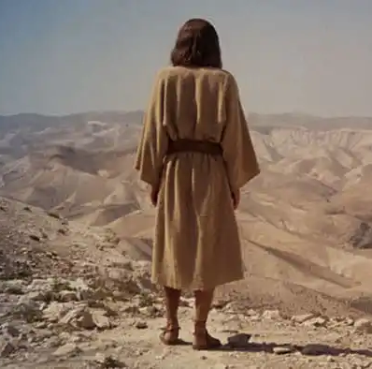
Luke 4:1-13
The Temptations of Jesus

Slide 2
Luke 4:1-7
Jesus, full of the Holy Spirit, left the Jordan and was led by the Spirit into the wilderness, where for forty days he was tempted[a] by the devil. He ate nothing during those days, and at the end of them he was hungry.
The devil said to him, “If you are the Son of God, tell this stone to become bread.”
Jesus answered, “It is written: ‘Man shall not live on bread alone.’”
The devil led him up to a high place and showed him in an instant all the kingdoms of the world. And he said to him, “I will give you all their authority and splendour; it has been given to me, and I can give it to anyone I want to. If you worship me, it will all be yours.”

Slide 3
Luke 4:8-13
Jesus answered, “It is written: ‘Worship the Lord your God and serve him only.’”
The devil led him to Jerusalem and had him stand on the highest point of the temple. “If you are the Son of God,” he said, “throw yourself down from here. For it is written:
“‘He will command his angels concerning you
to guard you carefully;
they will lift you up in their hands,
so that you will not strike your foot against a stone.’[d]”
Jesus answered, “It is said: ‘Do not put the Lord your God to the test.’”
When the devil had finished all this tempting, he left him until an opportune time.

Slide 4
What can we learn from Jesus about recognising and resisting temptations; and living a faithful life?

Slide 12
Jesus Answer!
Truth
Reality
Identity

Slide 15
Behaviour Feeling Need

Slide 16
Reflect and Discuss
Am I confident in God’s love for me?
What struggle surface in my life presently?
Where have I resisted God this week?
What Scriptures do I turn to in a time of temptation?

