Slide 1
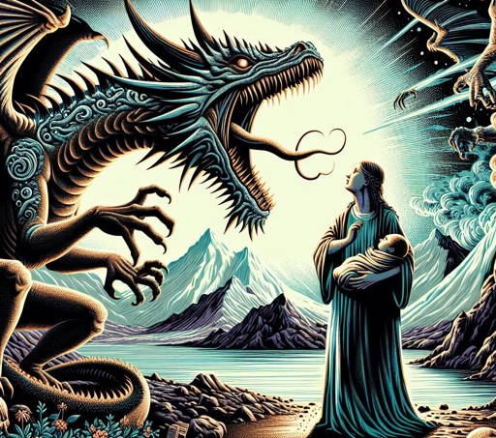
Revelation
Chapters 12-16

Slide 3
The book of Revelation is a 1st Century revelation of Jesus; against the Roman Empire; to the church(es); for the purpose of worship, encouragement and hope.

Slide 5
Revelation 12

Slide 6
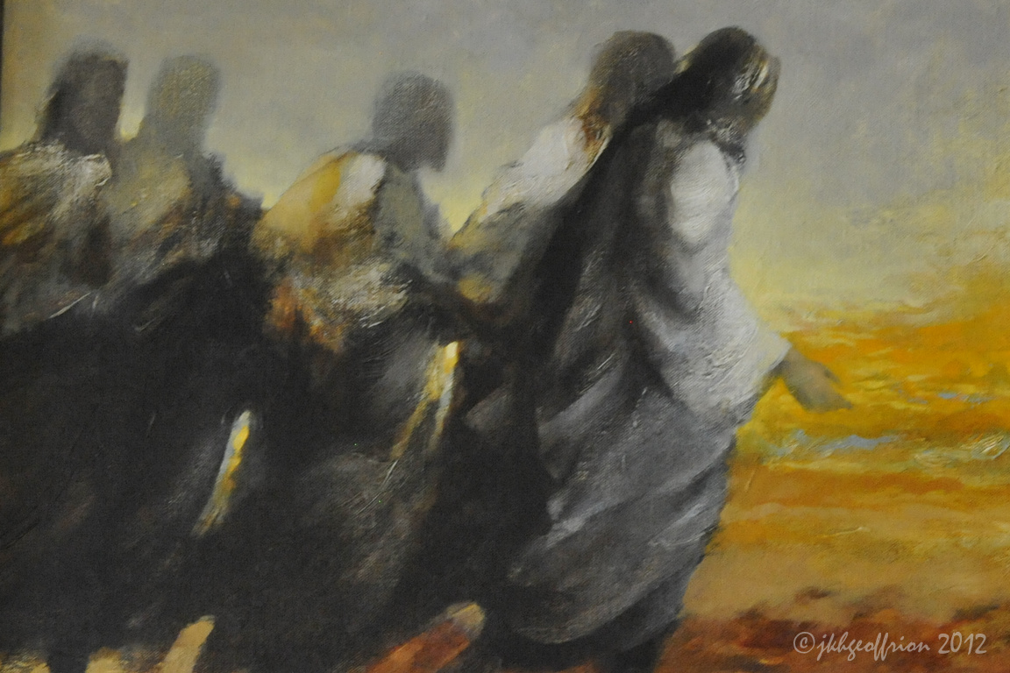
Revelation 12:1-6
A great sign appeared in heaven: a woman clothed with the sun, with the moon under her feet and a crown of twelve stars on her head. She was pregnant and cried out in pain as she was about to give birth. Then another sign appeared in heaven: an enormous red dragon with seven heads and ten horns and seven crowns on its heads. Its tail swept a third of the stars out of the sky and flung them to the earth. The dragon stood in front of the woman who was about to give birth, so that it might devour her child the moment he was born. She gave birth to a son, a male child, who “will rule all the nations with an iron scepter.” And her child was snatched up to God and to his throne. The woman fled into the wilderness to a place prepared for her by God, where she might be taken care of for 1,260 days.

Slide 7
Revelation 12:7-10
Then war broke out in heaven. Michael and his angels fought against the dragon, and the dragon and his angels fought back. But he was not strong enough, and they lost their place in heaven. The great dragon was hurled down—that ancient serpent called the devil, or Satan, who leads the whole world astray. He was hurled to the earth, and his angels with him.
Then I heard a loud voice in heaven say: “Now have come the salvation and the power and the kingdom of our God, and the authority of his Messiah. For the accuser of our brothers and sisters, who accuses them before our God day and night, has been hurled down.

Slide 8
Revelation 12:11-12
They triumphed over him
by the blood of the Lamb
and by the word of their testimony;
they did not love their lives so much
as to shrink from death.
Therefore rejoice, you heavens
and you who dwell in them!
But woe to the earth and the sea,
because the devil has gone down to you!
He is filled with fury,
because he knows that his time is short.”

Slide 9
Revelation 12:13-17
When the dragon saw that he had been hurled to the earth, he pursued the woman who had given birth to the male child. The woman was given the two wings of a great eagle, so that she might fly to the place prepared for her in the wilderness, where she would be taken care of for a time, times and half a time, out of the serpent’s reach. Then from his mouth the serpent spewed water like a river, to overtake the woman and sweep her away with the torrent. But the earth helped the woman by opening its mouth and swallowing the river that the dragon had spewed out of his mouth. Then the dragon was enraged at the woman and went off to wage war against the rest of her offspring—those who keep God’s commands and hold fast their testimony about Jesus.

Slide 10
Revelation 12

Slide 11
Revelation 12:11
They triumphed over him
by the blood of the Lamb
and by the word of their testimony;
they did not love their lives so much
as to shrink from death.

Slide 12
Revelation 13

Slide 13
Revelation 13:1-4
The dragon stood on the shore of the sea. And I saw a beast coming out of the sea. It had ten horns and seven heads, with ten crowns on its horns, and on each head a blasphemous name. The beast I saw resembled a leopard, but had feet like those of a bear and a mouth like that of a lion. The dragon gave the beast his power and his throne and great authority. One of the heads of the beast seemed to have had a fatal wound, but the fatal wound had been healed. The whole world was filled with wonder and followed the beast. People worshiped the dragon because he had given authority to the beast, and they also worshiped the beast and asked, “Who is like the beast? Who can wage war against it?”

Slide 14
Revelation 13:5-9
The beast was given a mouth to utter proud words and blasphemies and to exercise its authority for forty-two months. It opened its mouth to blaspheme God, and to slander his name and his dwelling place and those who live in heaven. It was given power to wage war against God’s holy people and to conquer them. And it was given authority over every tribe, people, language and nation. All inhabitants of the earth will worship the beast—all whose names have not been written in the Lamb’s book of life, the Lamb who was slain from the creation of the world.
Whoever has ears, let them hear.

Slide 15
Revelation 13:10-13
“If anyone is to go into captivity,
into captivity they will go.
If anyone is to be killed with the sword,
with the sword they will be killed.”
This calls for patient endurance and faithfulness on the part of God’s people.
Then I saw a second beast, coming out of the earth. It had two horns like a lamb, but it spoke like a dragon. It exercised all the authority of the first beast on its behalf, and made the earth and its inhabitants worship the first beast, whose fatal wound had been healed. And it performed great signs, even causing fire to come down from heaven to the earth in full view of the people.

Slide 16
Revelation 13:14-18
Because of the signs it was given power to perform on behalf of the first beast, it deceived the inhabitants of the earth. It ordered them to set up an image in honor of the beast who was wounded by the sword and yet lived. The second beast was given power to give breath to the image of the first beast, so that the image could speak and cause all who refused to worship the image to be killed. It also forced all people, great and small, rich and poor, free and slave, to receive a mark on their right hands or on their foreheads, so that they could not buy or sell unless they had the mark, which is the name of the beast or the number of its name.
This calls for wisdom. Let the person who has insight calculate the number of the beast, for it is the number of a man. That number is 666.

Slide 17
Revelation 13

Slide 18
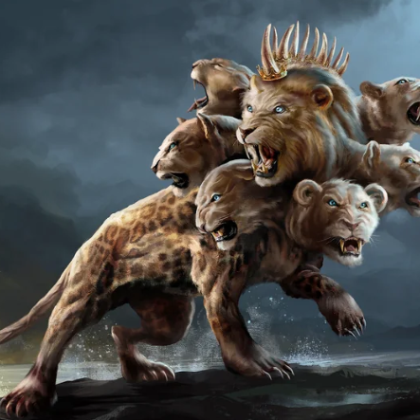
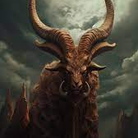
The Dragon The Devil
1st Beast Rome/
Empires
2nd Beast Local bureaucrats

Slide 19
6 - Nero
6 - Caesar
6 - Beast

Slide 20
Revelation 14

Slide 21
Revelation 14:1-5
Then I looked, and there before me was the Lamb, standing on Mount Zion, and with him 144,000 who had his name and his Father’s name written on their foreheads. And I heard a sound from heaven like the roar of rushing waters and like a loud peal of thunder. The sound I heard was like that of harpists playing their harps. And they sang a new song before the throne and before the four living creatures and the elders. No one could learn the song except the 144,000 who had been redeemed from the earth. These are those who did not defile themselves with women, for they remained virgins. They follow the Lamb wherever he goes. They were purchased from among mankind and offered as firstfruits to God and the Lamb. No lie was found in their mouths; they are blameless.

Slide 22
Revelation 14:6-9
Then I saw another angel flying in midair, and he had the eternal gospel to proclaim to those who live on the earth—to every nation, tribe, language and people. He said in a loud voice, “Fear God and give him glory, because the hour of his judgment has come. Worship him who made the heavens, the earth, the sea and the springs of water.”
A second angel followed and said, “‘Fallen! Fallen is Babylon the Great,’ which made all the nations drink the maddening wine of her adulteries.”
A third angel followed them and said in a loud voice: “If anyone worships the beast and its image and receives its mark on their forehead or on their hand,

Slide 23
Revelation 14:10-13
they, too, will drink the wine of God’s fury, which has been poured full strength into the cup of his wrath. They will be tormented with burning sulfur in the presence of the holy angels and of the Lamb. And the smoke of their torment will rise for ever and ever. There will be no rest day or night for those who worship the beast and its image, or for anyone who receives the mark of its name.” This calls for patient endurance on the part of the people of God who keep his commands and remain faithful to Jesus.
Then I heard a voice from heaven say, “Write this: Blessed are the dead who die in the Lord from now on.”
“Yes,” says the Spirit, “they will rest from their labor, for their deeds will follow them.”

Slide 24
Revelation 14:14-18
I looked, and there before me was a white cloud, and seated on the cloud was one like a son of man with a crown of gold on his head and a sharp sickle in his hand. Then another angel came out of the temple and called in a loud voice to him who was sitting on the cloud, “Take your sickle and reap, because the time to reap has come, for the harvest of the earth is ripe.” So he who was seated on the cloud swung his sickle over the earth, and the earth was harvested.
Another angel came out of the temple in heaven, and he too had a sharp sickle. Still another angel, who had charge of the fire, came from the altar and called in a loud voice to him who had the sharp sickle, “Take your sharp sickle and gather the clusters of grapes from the earth’s vine, because its grapes are ripe.”

Slide 25
Revelation 14:19-20
The angel swung his sickle on the earth, gathered its grapes and threw them into the great winepress of God’s wrath. They were trampled in the winepress outside the city, and blood flowed out of the press, rising as high as the horses’ bridles for a distance of 1,600 stadia.

Slide 26
Revelation 14

Slide 30
Revelation 15:1-3
I saw in heaven another great and marvelous sign: seven angels with the seven last plagues—last, because with them God’s wrath is completed. And I saw what looked like a sea of glass glowing with fire and, standing beside the sea, those who had been victorious over the beast and its image and over the number of its name. They held harps given them by God and sang the song of God’s servant Moses and of the Lamb:
“Great and marvelous are your deeds,
Lord God Almighty.
Just and true are your ways,
King of the nations.

Slide 31
Revelation 15:4-6
Who will not fear you, Lord,
and bring glory to your name?
For you alone are holy.
All nations will come
and worship before you,
for your righteous acts have been revealed.”
After this I looked, and I saw in heaven the temple—that is, the tabernacle of the covenant law—and it was opened. Out of the temple came the seven angels with the seven plagues. They were dressed in clean, shining linen and wore golden sashes around their chests.

Slide 32
Revelation 15:7-8
Then one of the four living creatures gave to the seven angels seven golden bowls filled with the wrath of God, who lives for ever and ever. And the temple was filled with smoke from the glory of God and from his power, and no one could enter the temple until the seven plagues of the seven angels were completed.

Slide 33
Revelation 16:1-4
Then I heard a loud voice from the temple saying to the seven angels, “Go, pour out the seven bowls of God’s wrath on the earth.”
The first angel went and poured out his bowl on the land, and ugly, festering sores broke out on the people who had the mark of the beast and worshiped its image.
The second angel poured out his bowl on the sea, and it turned into blood like that of a dead person, and every living thing in the sea died.
The third angel poured out his bowl on the rivers and springs of water, and they became blood.

Slide 34
Revelation 16:5-7
Then I heard the angel in charge of the waters say:
“You are just in these judgments, O Holy One,
you who are and who were;
for they have shed the blood of your holy people and your prophets,
and you have given them blood to drink as they deserve.”
And I heard the altar respond:
“Yes, Lord God Almighty,
true and just are your judgments.”

Slide 35
Revelation 16:8-12
The fourth angel poured out his bowl on the sun, and the sun was allowed to scorch people with fire. They were seared by the intense heat and they cursed the name of God, who had control over these plagues, but they refused to repent and glorify him.
The fifth angel poured out his bowl on the throne of the beast, and its kingdom was plunged into darkness. People gnawed their tongues in agony and cursed the God of heaven because of their pains and their sores, but they refused to repent of what they had done.
The sixth angel poured out his bowl on the great river Euphrates, and its water was dried up to prepare the way for the kings from the East.

Slide 36
Revelation 16:13-16
Then I saw three impure spirits that looked like frogs; they came out of the mouth of the dragon, out of the mouth of the beast and out of the mouth of the false prophet. They are demonic spirits that perform signs, and they go out to the kings of the whole world, to gather them for the battle on the great day of God Almighty.
“Look, I come like a thief! Blessed is the one who stays awake and remains clothed, so as not to go naked and be shamefully exposed.”
Then they gathered the kings together to the place that in Hebrew is called Armageddon.

Slide 37
Revelation 16:17-20
The seventh angel poured out his bowl into the air, and out of the temple came a loud voice from the throne, saying, “It is done!” Then there came flashes of lightning, rumblings, peals of thunder and a severe earthquake. No earthquake like it has ever occurred since mankind has been on earth, so tremendous was the quake. The great city split into three parts, and the cities of the nations collapsed. God remembered Babylon the Great and gave her the cup filled with the wine of the fury of his wrath. Every island fled away and the mountains could not be found. From the sky huge hailstones, each weighing about a hundred pounds, fell on people. And they cursed God on account of the plague of hail, because the plague was so terrible.

Slide 39
Reflect
Has this helped me understand the true nature of the world?
In what way was I invited into worship, encouraged or found hope?

