Slide 1
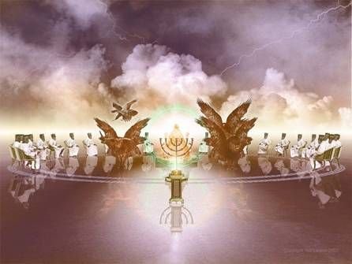
Revelation
Chapters 4-8a

Slide 3
The book of Revelation is a 1st Century revelation of Jesus; against the Roman Empire; to the church(es); for the purpose of worship, encouragement and hope.

Slide 4
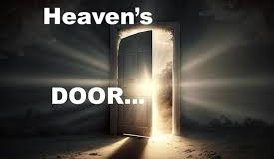
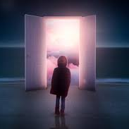
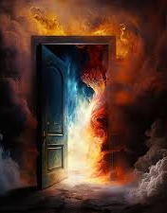
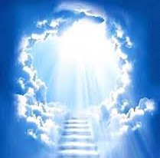
In what way do you imagine the door to heaven?

Slide 8
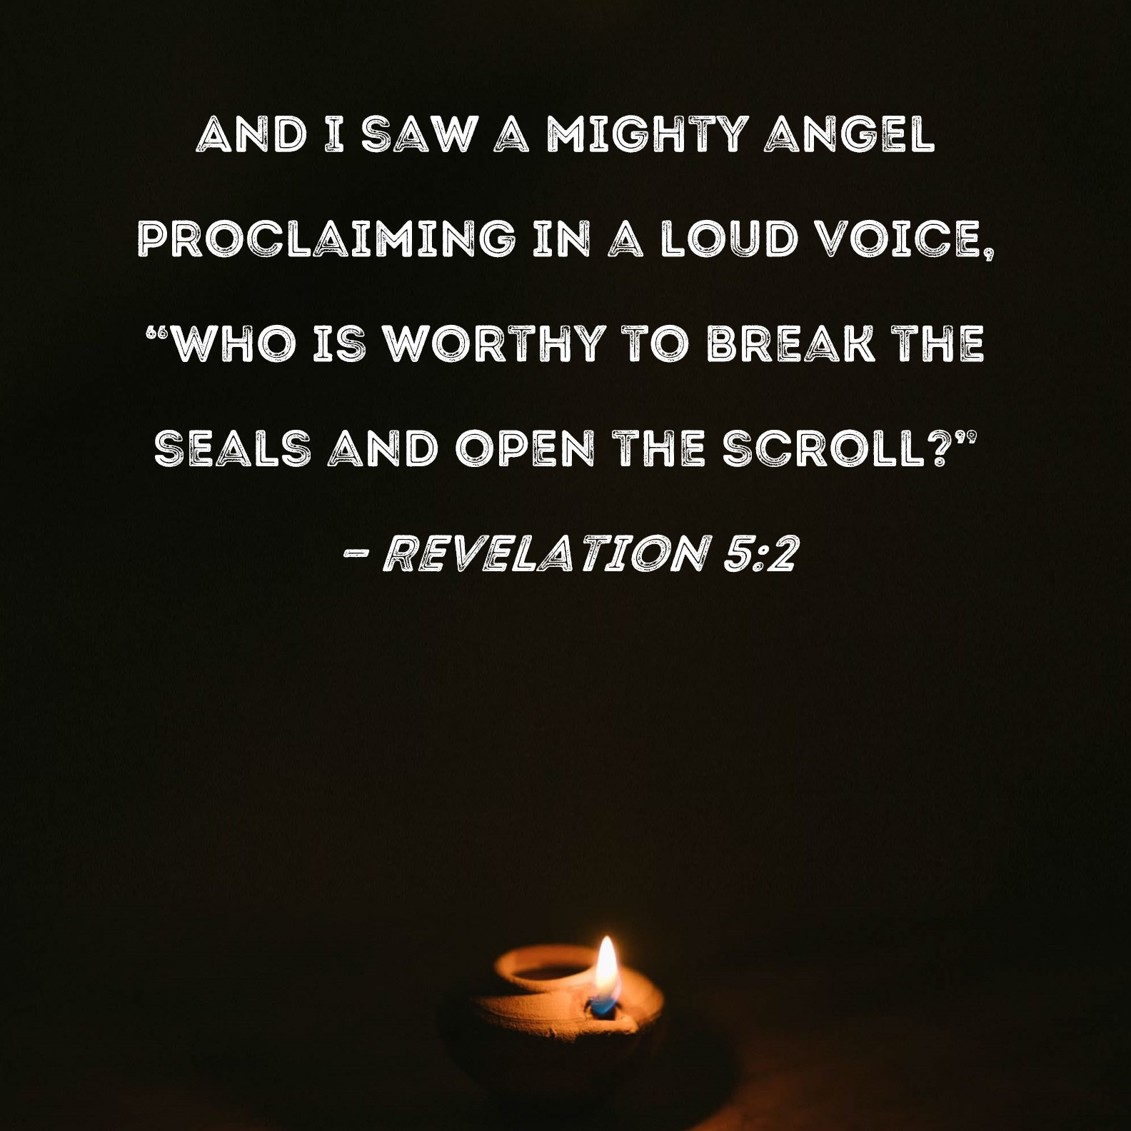

Slide 9
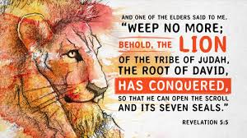

Slide 10
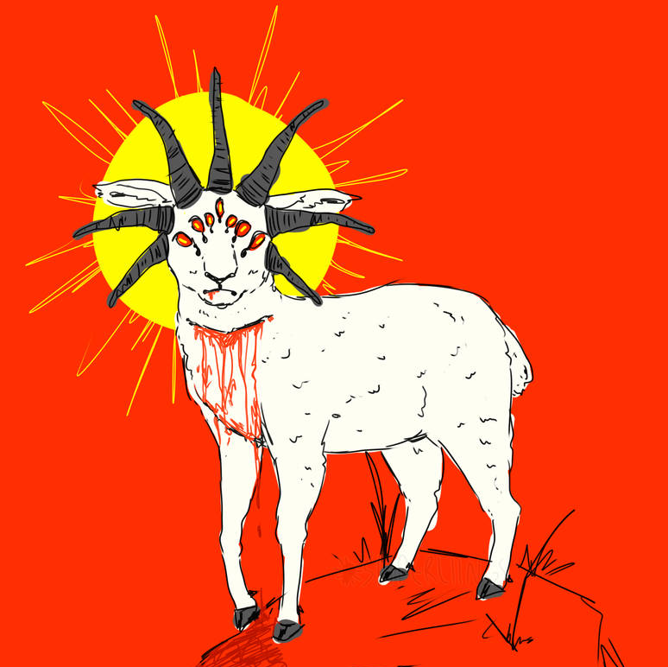
Saw – One like a slaughtered lamb

Slide 11
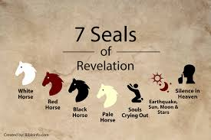
Chapters 6:1-8:1

Slide 12
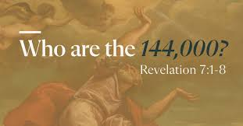

Slide 13
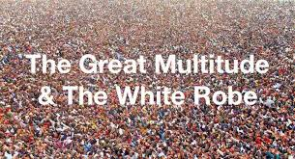

Slide 14
Awesome!

Slide 15
Reflect
What struck me from the text that brought me to awe or worship, encouragement or hope?

