Slide 1
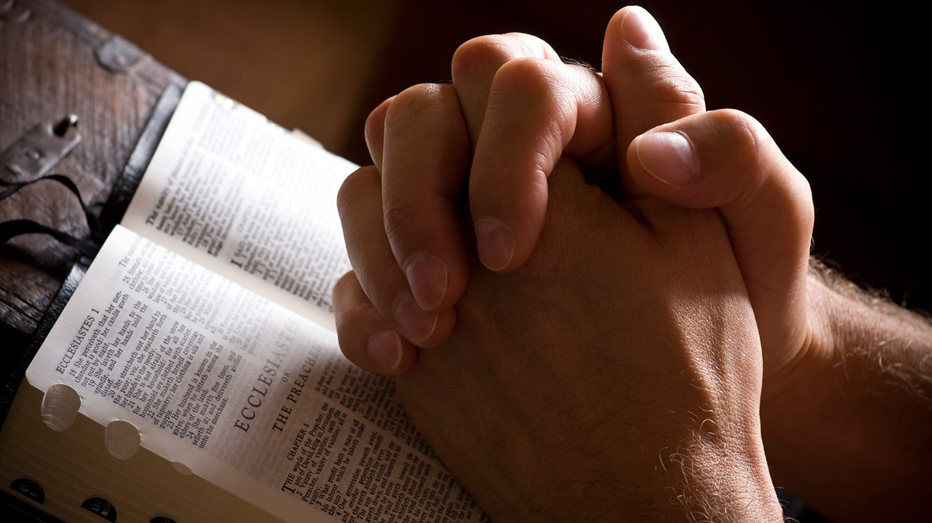
Prayer – Part 4
Being with God Ephesians 3:18

Slide 2
Talking to God
Talking with God
Listening to God
Being with God

Slide 3
Silence

Slide 4
Contemplation

Slide 5
Contemplation
Gazing
Yielding
Resting

Slide 6
Gazing

Slide 7
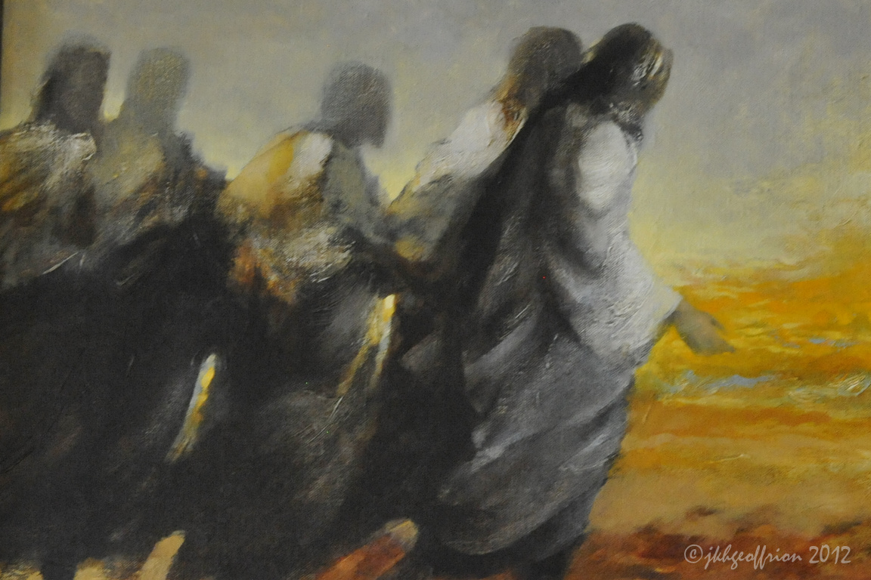
2 Corinthians 3:18
“We all, who with unveiled faces contemplate the Lord’s glory, are being transformed into his image with ever-increasing glory.”

Slide 8
Gazing

Slide 9
“Faith is not a once-done act, but a continuous gaze of the heart at the Triune God. Believing, then, is directing the heart’s attention to Jesus. It is lifting the mind to “behold the Lamb of God,” and never ceasing that beholding for the rest of our lives. At first this may be difficult, but it becomes easier as we look steadily at His wondrous Person, quietly and without strain.” A. W. Tozer

Slide 11
Boventure
Eye of the Body
Eye of the Mind
Eye OF THE Heart

Slide 12
“To pray is to descend with the mind into the heart, and there to stand before the face of the Lord, ever-present, all seeing, within you.” St. Theophan the Recluse
We “remain in loving attention on God.” St John of the Cross

Slide 13
Yielded to His Love

Slide 14
“The deep inner posture of a joyful release of our life and being to God in absolute trust, without demands, without conditions, without reservation… [it is] neither a passive resignation nor a fatalistic acquiescence to whatever comes. It is, rather, a consistent posture of actively turning our whole being to God so that God’s presence, purpose, and power can be released through our lives into all situations.” Robert Mulholland
“Love on fire with devotion.” Walter Hilton

Slide 15
Resting in God’s Love

Slide 16
Ephesians 3:16-19
“I pray that out of his glorious riches he may strengthen you with power through his Spirit in your inner being, so that Christ may dwell in your hearts through faith. And I pray that you, being rooted and established in love, may have power, together with all the Lord’s holy people, to grasp how wide and long and high and deep is the love of Christ, and to know this love that surpasses knowledge—that you may be filled to the measure of all the fullness of God.”

Slide 17
“Silent Love.” St Teresa of Avila
“True, whole prayer is nothing but love.” St Augustine

Slide 18
Spiritual Formation

Slide 19
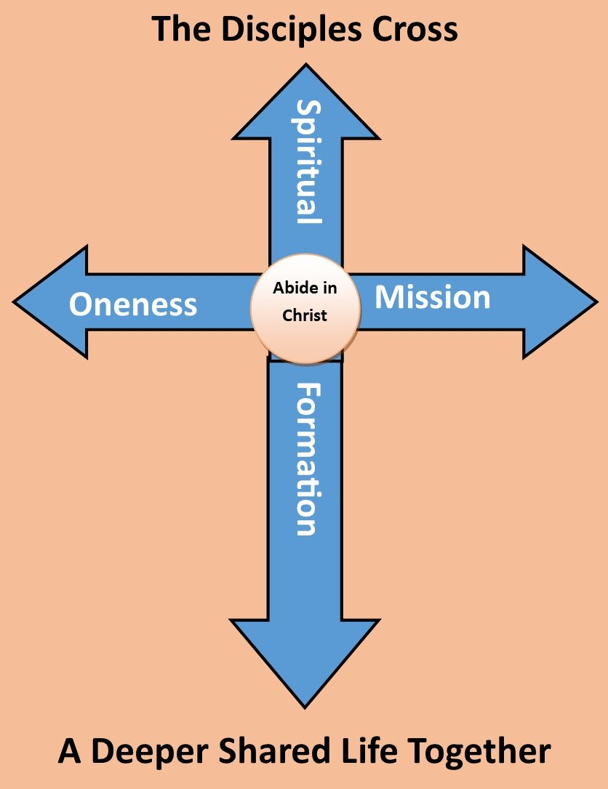
2 Corinthians 3:18
“We all, who with unveiled faces contemplate the Lord’s glory, are being transformed into his image with ever-increasing glory.”

Slide 20
“You are what your mind looks at; you are what you contemplate.” Hwee Hwee Tan

Slide 21
“If you contemplate God long enough, something surprising happens in the brain. Neural functioning begins to change… [we have ] a nervous system that actively participates in its own neural construction, something we do not see in other animal brains.” Dr Andrew Newberg

Slide 22
Psalm 34:5
“Those who look to him are radiant…..”

Slide 23
Distraction

Slide 24
Hurry

Slide 25
“You must ruthlessly eliminate hurry from your life.” Dallas Willard
“Wasting time on God” Henri Nouwen

Slide 26
Fear

Slide 27
Slow down to the speed of Love

Slide 28
Gazing at God, gazing at you in love, yielding to his love, and resting in his love

Slide 29
This week on your own:
Sit in God’s loving presence

Slide 30
This week in your groups:
Sit together in God’s presence

Slide 31
Gazing at God, gazing at you in love, yielding to his love, and resting in his love

